Slide 1
Bank Loan Case Study

Slide 2
PROJECT DESCRIPTION
The given project asks us to apply Risk Analytics by analysing the data given for bank loan.
The project expects us to perform Exploratory Data Analysis to understand how consumer attribute which influence the tendency to default.
By EDA we will identify patterns of loan default and the driving factors which leads to these defaults. For this which has strong indicators of default are found.
We are expected to manage missing data, identify outliers, report any data imbalance, explain the result of univariate, Segmented univariate, and bivariate analysis and correlation for the client with payment difficulties and all other cases.

Slide 3
Approach and Missing Values
Identify the null values of each columns.
Drop those columns with missing value % greater than 40%.
Delete unwanted columns.
There are 100 columns were droped.

Slide 4
Approach and Missing Values
COUNTBLANK('O A '!A1:A50000) using this formula for find number of null values in each columns.
D2/50000*100 using this formula for find percentage of null in each columns.
Use conditional formatting to highlight cells.

Slide 5
Handling missing values
IN AMT_ANNUITY, CNT_FAM_MEMBERS and DAYS_BIRTH column fill with average value.
In AMT_GOODS_PRICE column all values in it are only equal to or greater than the value in the AMT_CREDIT column, so I entered the same value in the AMT_CREDIT column as in the AMT_GOODS_PRICE col.
In OCCUPATION_TYPE column fill with mode.

Slide 6
Outliers
QUARTILE(application!H:H,1,2,3) using this formula for find first, second and third quartile.
Q3-Q1 is formul for find IQR.
Formula for finding Upper bound is (Q3+1.5*IQR) and lower bound formula is (Q1-1.5*IQR).
This way to find the outlier for each row. Which values are more or less in between Upper bound and lower bound consider as outliers.

Slide 7
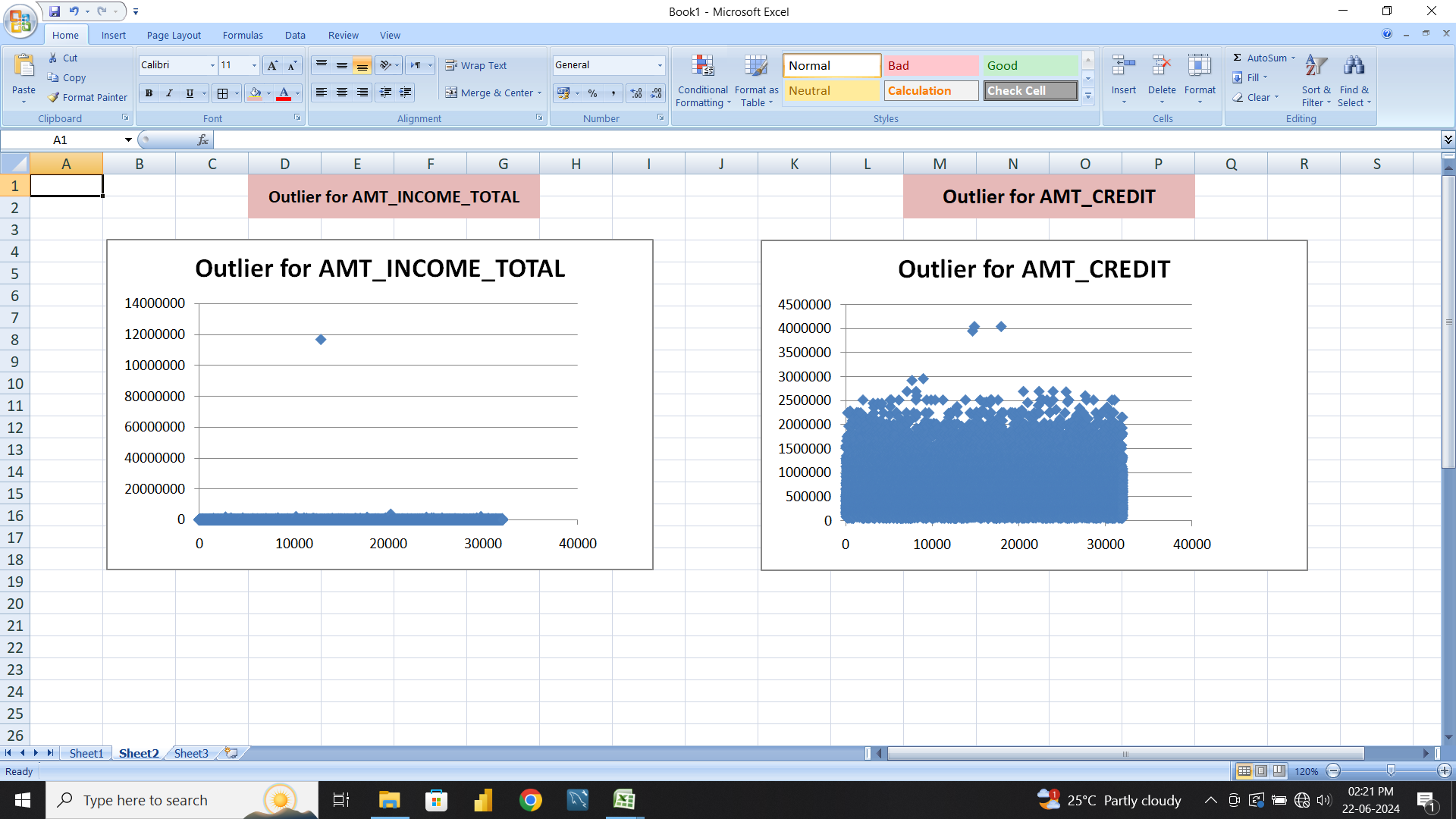
Outliers
In AMT_INCOME_TOTAL col one outliers is found 1.2cr, this is too far compare to other values.
• In AMT_CREDIT col lot of outlier values was found near 20L to 40L, other values are between 25000 to 16L.

Slide 8
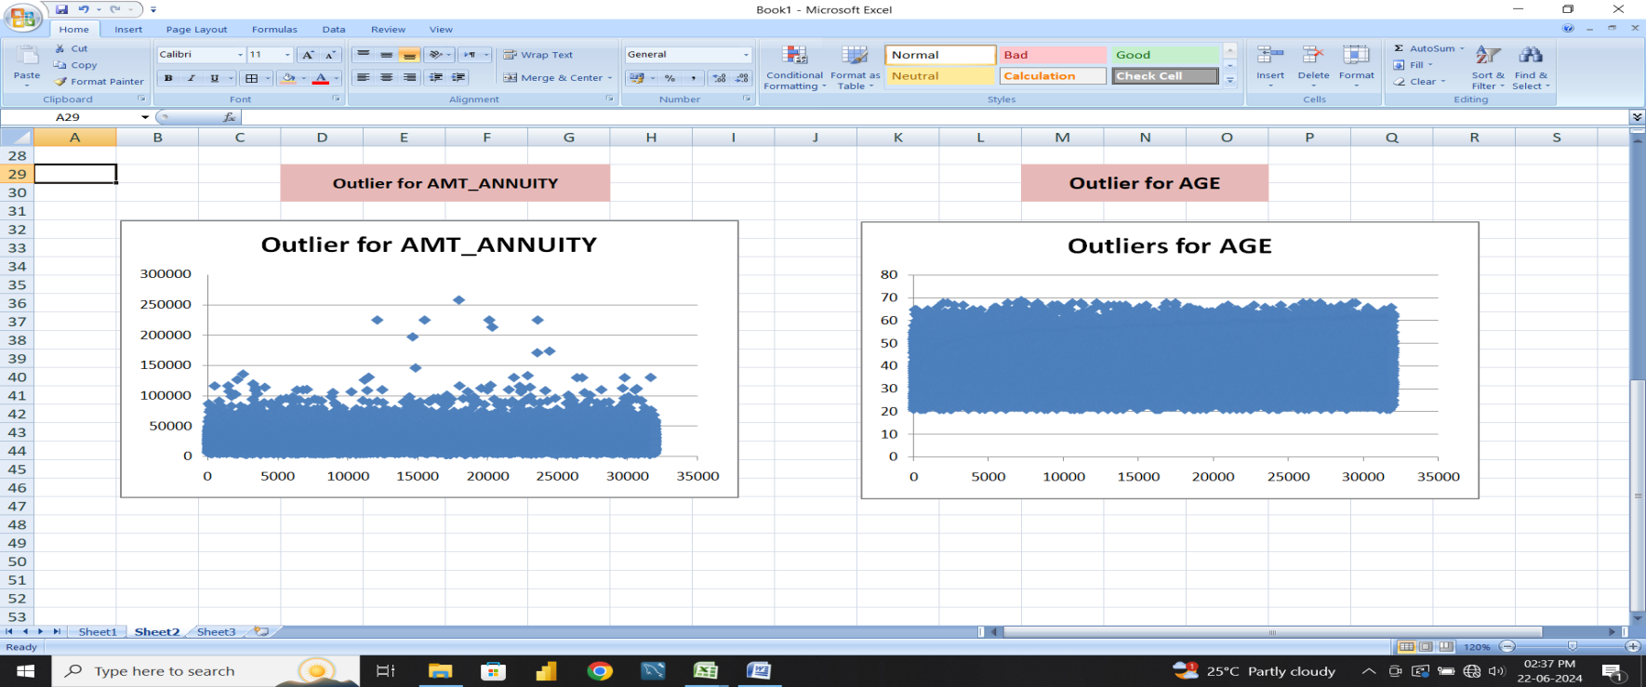
Outliers
In AMT_ANNUITY col lot of outlier values was found in different areas, other values are between 0 to 85k.
In AGE col there is no outliers, all values are into the upper and lower bound.

Slide 9
Data Imbalance
Target Applicants 1 - client with payment difficulties: Customer had late payment or not paid, 0 - all other cases.
Out of total application 49999, the number of applicants which make payment on time is 45973.
The number of applicants with payment difficulties is 4026.

Slide 10
Univariate and Bivariate Analysis
Gender Wise Application Count
Female applicants was high number totally 32,823
30559 applicants paying on the time but 2264 applicants not paying regularly.
Out of 17,174 male applicants 15412 people paying on the time but 1762 applicants not paying regularly.
Male are high defaulter have 10.4% compare to the female have 8.6%.
XNA only 2 applicant and there is no difficulty payers.

Slide 11
Univariate and Bivariate Analysis
Target Applicants by Age
Middle age group (26-50) people most application was came.
Young and older age people application was less.
Highest application number 7007 was comes in 36-40.
Each age group have a difficulty payers.

Slide 12
Univariate and Bivariate Analysis
Almost 50% of our applicant’s occupation was labours 24,606.
Least number of applicants was IT staffs only 80.

Slide 13
Univariate and Bivariate Analysis
Target Application count by Income
Majority of the income range between 25k-2.5L.
Most of difficulty payers also there range.
A big difference to seen in 1.5L-2.5 range to 2.5l-3.5L range.
Even all range of difficulty payers are there, but the number of difficulty payer is too low.

Slide 14
Univariate and Bivariate Analysis
Difficulty Payer's Family Count
A low income range people average family member is 2.
Max children count is 13, this now generation 10 or 13 children is unusual.
But there is chance to mostly 3 or 4 children in a family

Slide 15
Correlations between Age/Family count/Children count/Income/Loan Amount/Annuity
 | TARGET | AGE | CNT_FAM_MEMBERS | CNT_CHILDREN | AMT_INCOME_TOTAL | AMT_ANNUITY | AMT_CREDIT | AMT_GOODS_PRICE
TARGET | 1
AGE | -0.076787909 | 1
CNT_FAM_MEMBERS | 0.012999748 | -0.277039246 | 1
CNT_CHILDREN | 0.026363931 | -0.329077466 | 0.880452047 | 1
AMT_INCOME_TOTAL | 0.010893745 | -0.015814826 | 0.01121381 | 0.009588558 | 1
AMT_ANNUITY | -0.01238765 | -0.007537554 | 0.077409198 | 0.026199394 | 0.083004992 | 1
AMT_CREDIT | -0.032428347 | 0.059393938 | 0.063992033 | 0.00497156 | 0.069315897 | 0.76948508 | 1
AMT_GOODS_PRICE | -0.041148996 | 0.058131719 | 0.06142297 | 0.000130449 | 0.069879719 | 0.774156102 | 0.986531446 | 1
• CORREL('application'!AI:AI,'application'!AP:AP) using this formula to find correlation between all col. Excellent correlation between these columns.
• AMT_CREDIT vs AMT_GOODS_PRICE.
• AMT_ANNUITY vs AMT_CREDIT vs AMT_GOODS_PRICE.
• CNT_FAM_MEMBERS vs CNT_CHILDREN.
• Other col correlation was poor, In this overall correlation we cannot conclude correct decision. Then here I did anther view.

Slide 16
Difficulty Payer's Correlations between Age/Family count/Children count/Income/Loan Amount/Annuity
 | AGE | CNT_FAM_MEMBERS | CNT_CHILDREN | AMT_INCOME_TOTAL | AMT_ANNUITY | AMT_CREDIT | AMT_GOODS_PRICE
AGE | 1
CNT_FAM_MEMBERS | -0.199576632 | 1
CNT_CHILDREN | -0.24993433 | 0.892542867 | 1
AMT_INCOME_TOTAL | -0.008413161 | 0.013115005 | 0.010106082 | 1
AMT_ANNUITY | 0.008587132 | 0.075726469 | 0.029110896 | 0.01800185 | 1
AMT_CREDIT | 0.142131359 | 0.061011027 | 0.007475275 | 0.015266522 | 0.749659476 | 1
AMT_GOODS_PRICE | 0.140783607 | 0.055417208 | -0.000742782 | 0.013296322 | 0.749898622 | 0.98234248 | 1
• This table was shows difficulty payer's correlation amoung the col.
• This correlation also shows same result of seen before.
• But AMT_INCOME_TOTAL vs AMT_ANNUITY vs AMT_CREDIT vs AMT_GOODS_PRICE co-re is goan down comparitively before table.

Slide 17
Other Payer's Correlations between Age/Family count/Children count/Income/Loan Amount/Annuity
 | AGE | CNT_FAM_MEMBERS | CNT_CHILDREN | AMT_INCOME_TOTAL | AMT_ANNUITY | AMT_CREDIT | AMT_GOODS_PRICE
AGE | 1
CNT_FAM_MEMBERS | -0.284169565 | 1
CNT_CHILDREN | -0.335678262 | 0.879236611 | 1
AMT_INCOME_TOTAL | -0.073658948 | 0.041530972 | 0.036319722 | 1
AMT_ANNUITY | -0.009726958 | 0.077924604 | 0.026404205 | 0.451114642 | 1
AMT_CREDIT | 0.051143637 | 0.064871588 | 0.005705458 | 0.377965752 | 0.770758487 | 1
AMT_GOODS_PRICE | 0.049275852 | 0.062690335 | 0.001367979 | 0.384454763 | 0.775831703 | 0.986810609 | 1
• This table was shows other payer's correlation among the col.
• This correlation was much better than before two col.
• Seen the AMT_INCOME_TOTAL vs AMT_ANNUITY vs AMT_CREDIT vs AMT_GOODS_PRICE co-or was moderately correlated.
• That is the reason for they pay amount on the time.

Slide 18
Conclusion
After analysing the dataset, there are few attributes of a client with which the bank would be able to identify if they will repay the loan or not.
Majority of the income range between 25k-2.5L.
Most of difficulty payers also there range, because low income range people average of 2.5 to max of 13 member in their family.
It should be one of the reason for they facing difficulty in payments.
Applicants earn the higher income difficulty payer counts was low.

Slide 19
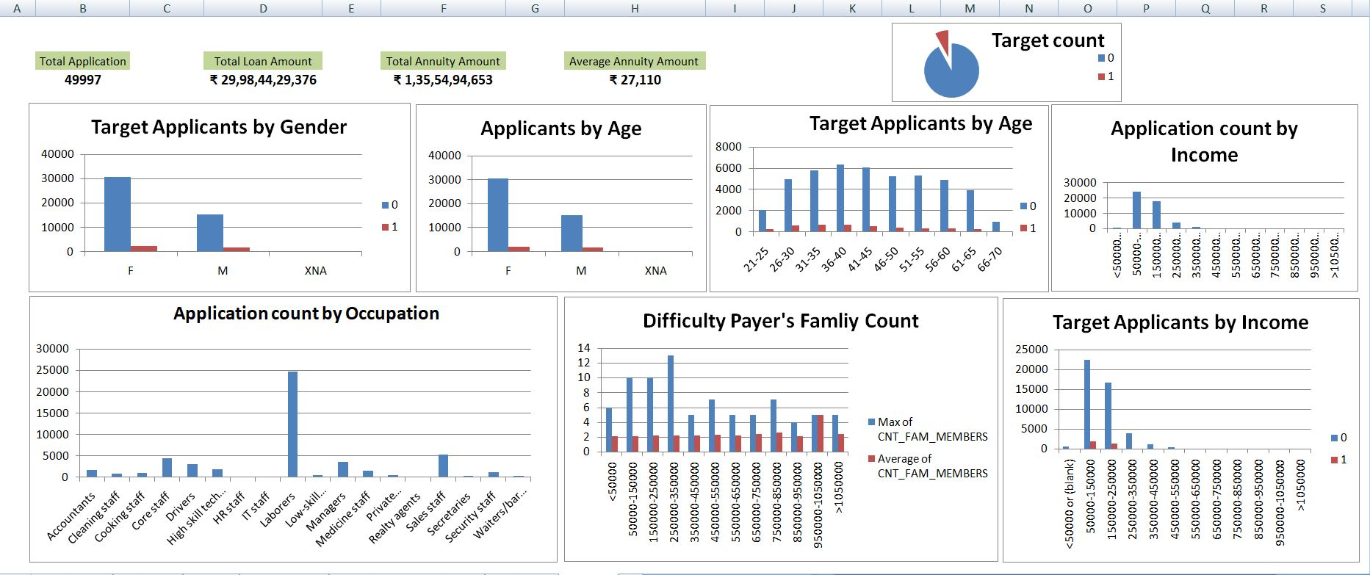
Univariate and Bivariate Analysis Visuals

